Slide 1
Explaining Image Classification Results
Mousa Farshkar Azari
CS555 Introduction to Computer Vision Selected Paper: Explaining Image Classifiers
using Statistical Fault Localization

Slide 2
Outline
XAI
Related Work
Methodology
Results

Slide 3
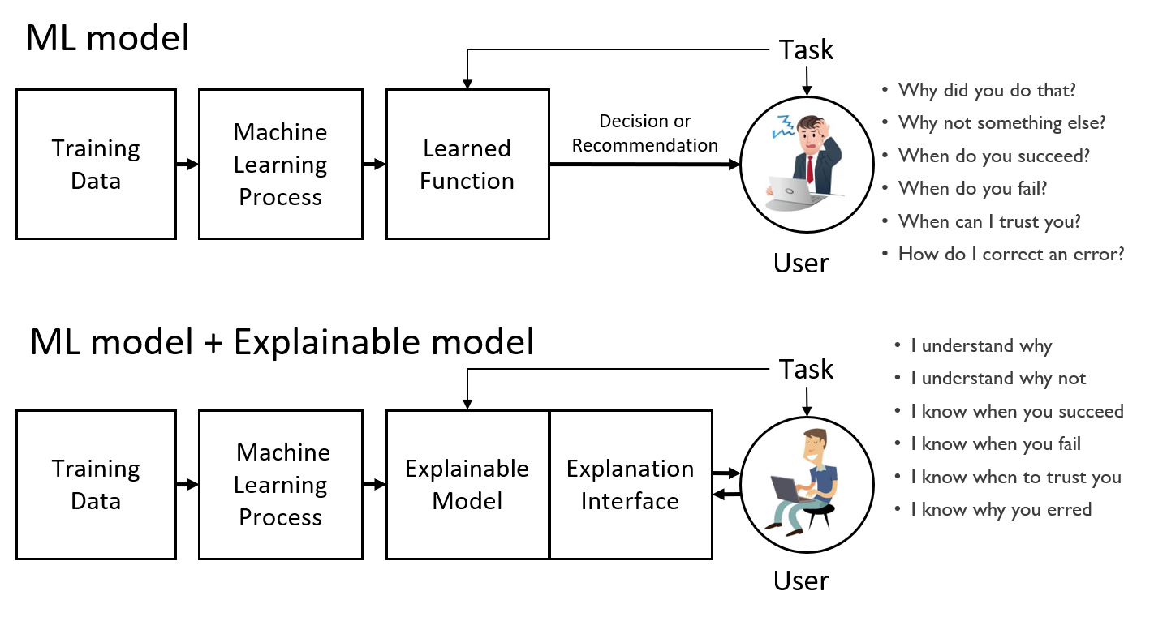
(Explainable Artificial Intelligence) XAI

Slide 4
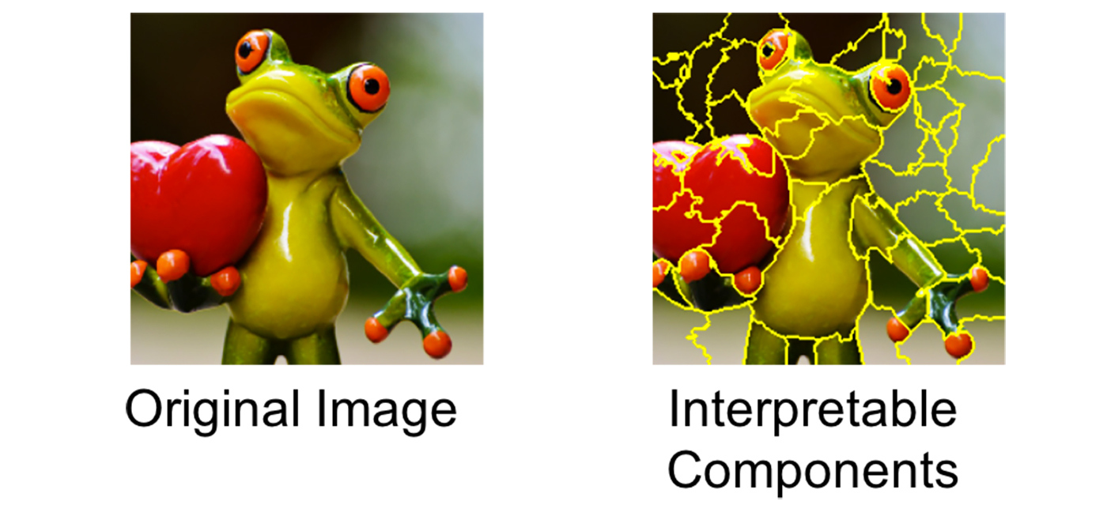
LIME [1]
LIME stands for Local interpretable model-agnostic explanations.
The explanation is generated by bringing the original model (black box) closer to the explained model
Tries to understand the model by perturbating the input data and understanding how these changes affect the predictions.

Slide 5
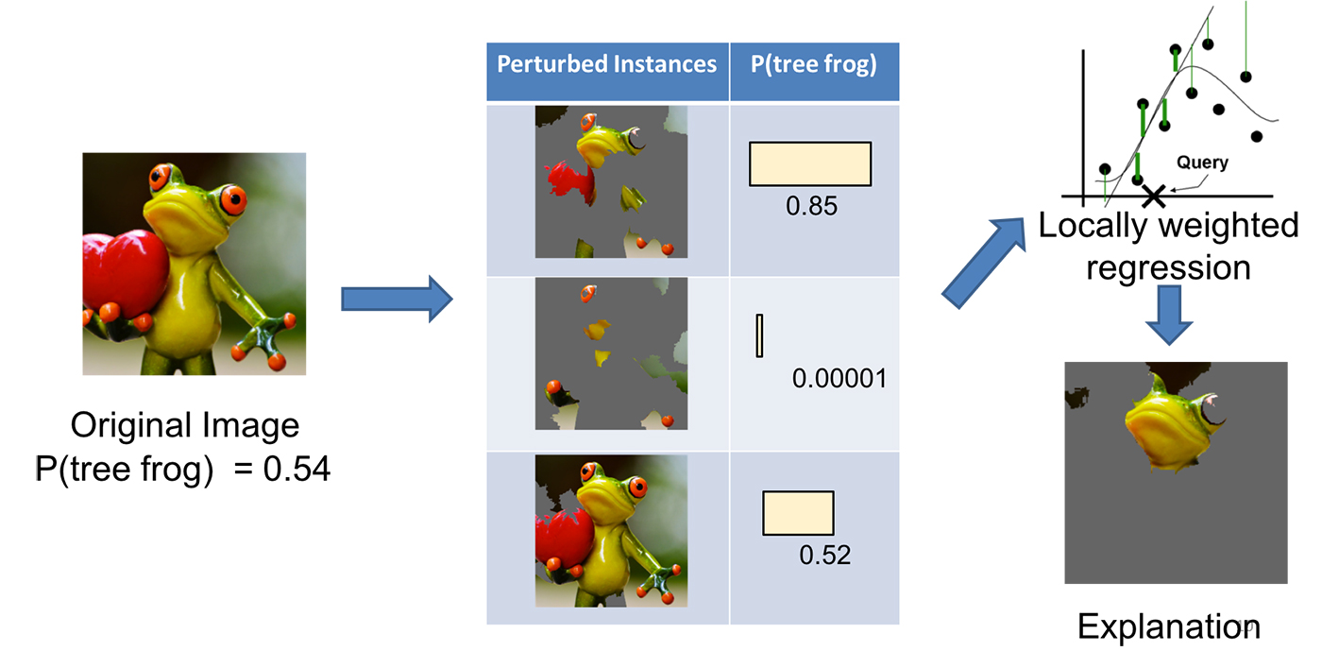

Slide 6
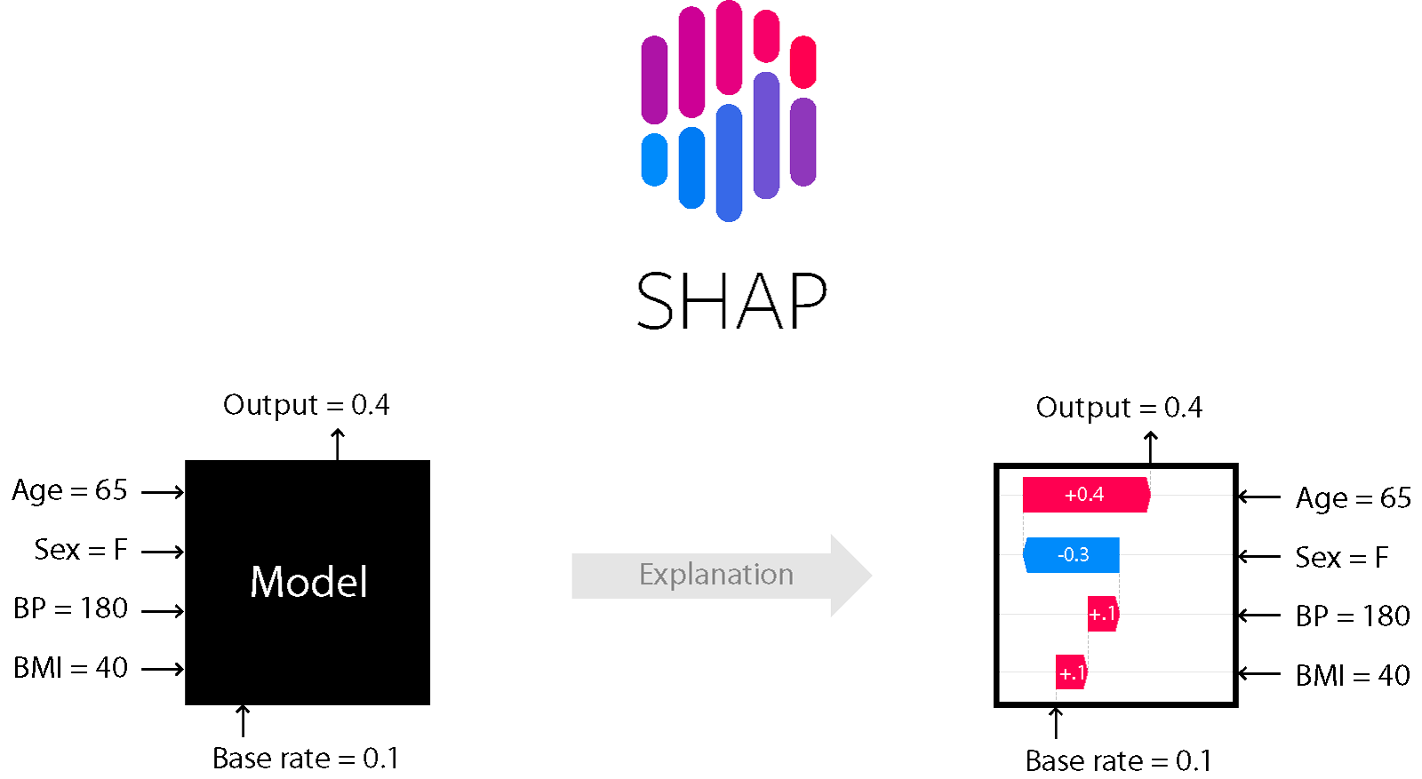
SHAP [2]
SHAP stands for SHapley Additive exPlanations.
a "game theoretical" method for interpreting the results of any model in deep learning.
additive and model-agnostic methods of explaining individual predictions
explain model prediction for given input by computing the contribution of each feature to this prediction

Slide 7

ELi5 [3]
Explains image classifier predictions with a method called Grad-CAM
Interpret the predictions of Image Classifiers written in Keras
Leverages Gradient-weighted Class Activation Mapping (Grad-CAM) algorithm
Using the values of activation maps as well as backpropagation to understand the source of the prediction.

Slide 8
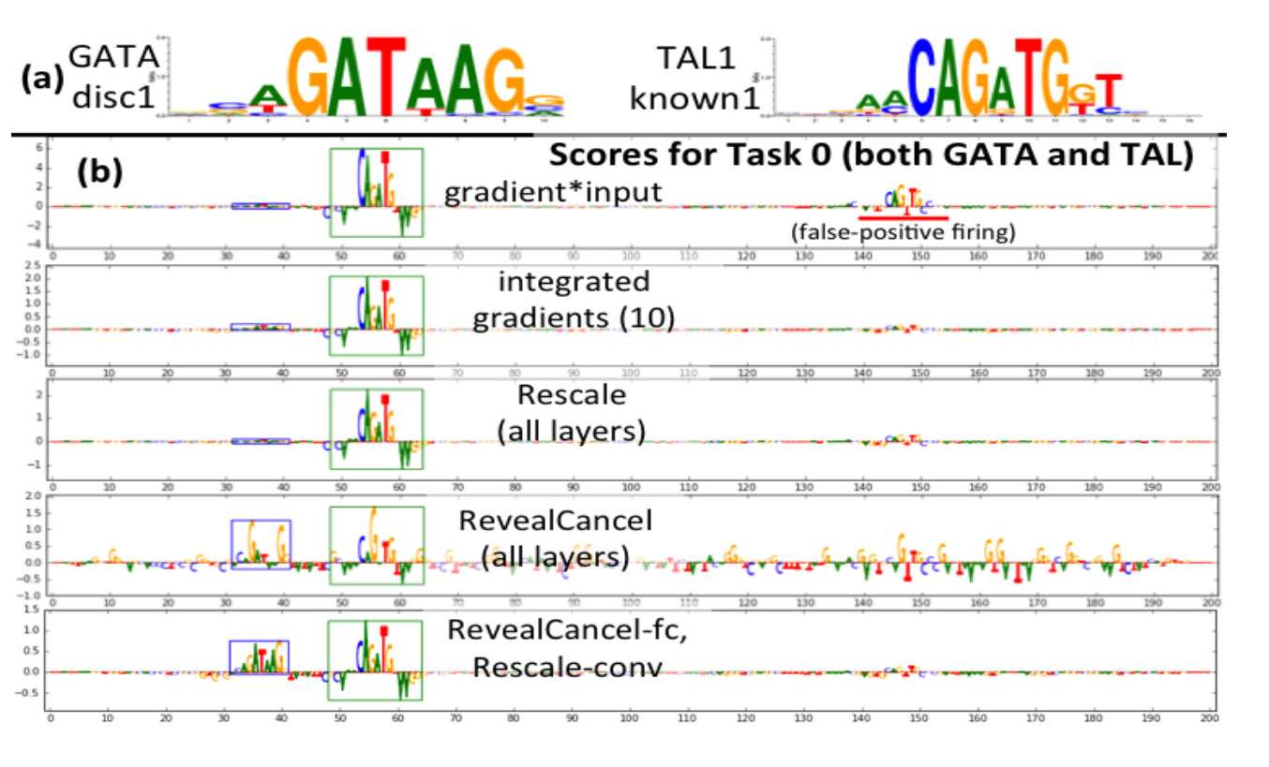
Deeplift [4]
DeepLIFT stand for (Deep Learning Important FeaTures)
a method for decomposing the output prediction of a neural network on a specific input by backpropagating the contributions of all neurons in the network to every feature of the input
DeepLIFT compares the activation of each neuron to its ‘reference activation’ and assigns contribution scores according to the difference

Slide 9
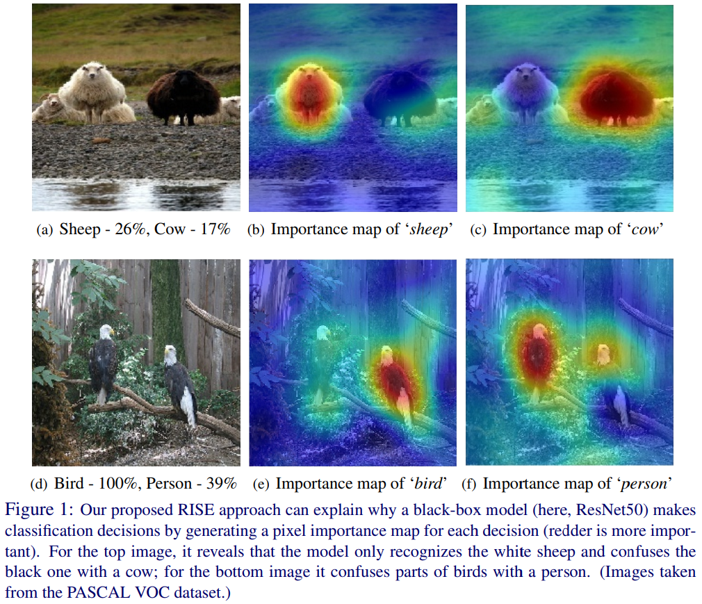
RISE [5]
Randomized Input Sampling for Explanation of Black-box Models
generates an importance map indicating how salient each pixel is for the model’s prediction
by probing the model with randomly masked versions of the input image and obtaining the corresponding outputs

Slide 10
Explaining Image Classifiers
using Statistical Fault Localization [7]
Statistical fault localization (SFL) techniques from software engineering deliver high quality explanations of the outputs of DNNs.
This work present an algorithm and a tool called DeepCover, which synthesizes a ranking of the features of the inputs using SFL and constructs explanations for the decisions of the DNN based on this ranking.

Slide 11
Datasets
MNIST
Cat Dog Panda

Slide 12
Methodology
generated our training and test data by using image generator from TensorFlow
custom convolutional neural network for classifying images that contain three convolutional layers before I flatten it and a fully connected layer as the last layer of my model

Slide 13
The kernel size in convolutional layers is 3x3
used Relu activation in all of them.
After each convolutional layer, there is a (2,2) max-pooling.
In the dense hidden layer, the dropout value is 0.2 and again I have used the Relu activation function.
In the output neuron, there are three options as cat, dog, and panda. In the output layer, I have used Softmax to get probabilities.

Slide 14
Novelty
Main goal of this work is not to provide best image classification model nor to use very large datasets, the aim is to provide better and more meaningful explanations which as you can see in the figures it is really promising result.
LIME + SFL

Slide 15
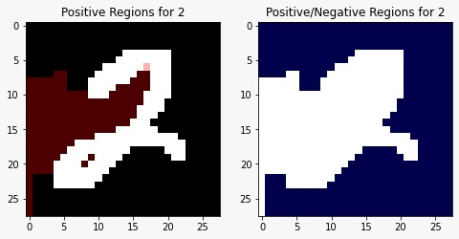
Results

Slide 16
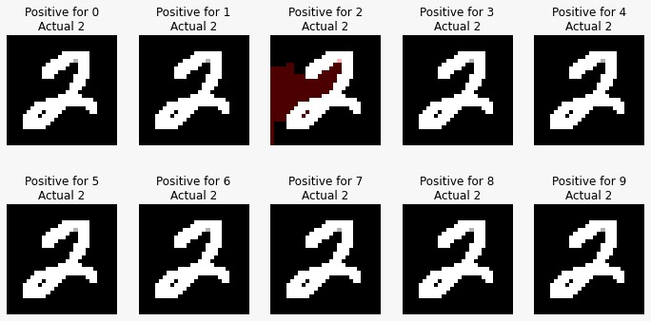
Results

Slide 17
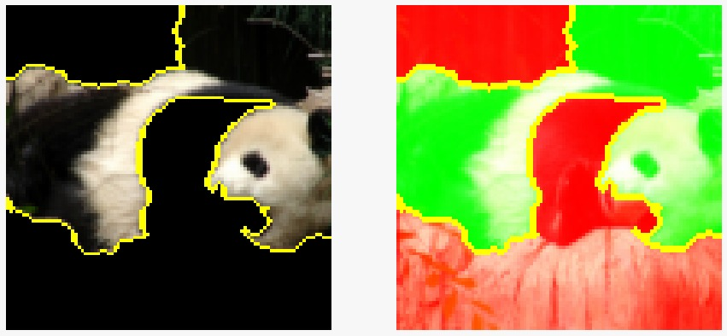
Results

Slide 18
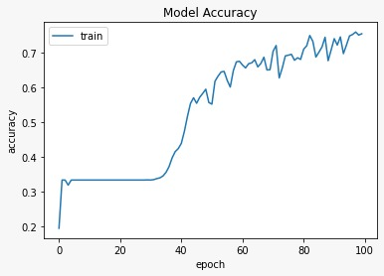
Results

Slide 19
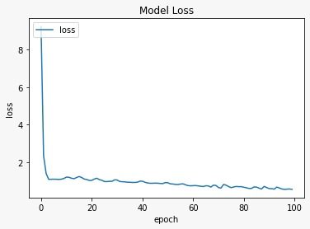
Results

Slide 20
Conclusion
As you can see this model can give us much more understandable explanations of the results and we find out how we came up up with a certain result.
This work is first of a kind explaining method with uses LIME and SFL at the same time.

Slide 21
References
[1] Ribeiro, M.T., Singh, S., Guestrin, C.: \Why should I trust you?" Explaining the predictions of any classifier. In: Knowledge Discovery and Data Mining (KDD). pp. 1135{1144. ACM (2016)
[2] Lundberg, S.M., Lee, S.I.: A unified approach to interpreting model predictions. In: Advances in Neural Information Processing Systems. pp. 4765{4774 (2017) [3] Christoph Molnar, Interpretable Machine Learning A Guide for Making Black Box Models Explainable, 2020-02-28
[4] Shrikumar, Avanti, Peyton Greenside, and Anshul Kundaje. "Learning important features through propagating activation differences." International Conference on Machine Learning. PMLR, 2017.
[5] Petsiuk, V., Das, A., Saenko, K.: RISE: randomized input sampling for explanation of black-box models. In: British Machine Vision Conference (BMVC). BMVA Press (2018)
[6] Sun, Youcheng, et al. "Explaining Image Classifiers using Statistical Fault Localization." European Conference on Computer Vision. Springer, Cham, 2020.
[7] Jeyakumar, Jeya Vikranth, et al. "How can i explain this to you? an empirical study of deep neural network explanation methods." Advances in Neural Information Processing Systems (2020).
[8] Selvaraju, R.R., Cogswell, M., Das, A., Vedantam, R., Parikh, D., Batra, D.: GradCAM: Visual explanations from deep networks via gradient-based localization. In: International Conference on Computer Vision (ICCV). pp. 618{626. IEEE (2017)

